Slide 1
European Sources
Matricula-Online / Archion /Geneanet
David F. Lahrmann

Slide 2
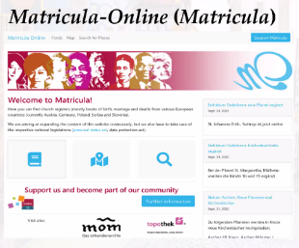

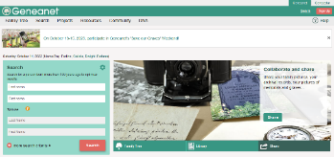
Sources for German Birth, Marriage and Death Records
Martricula – Online
  Free access
  https://data.matricula-online.eu/en/
Achion
  Fee based service
  https://www.archion.de/en/
Geneanet
  Free for basic access
  Pay for full access
  https://en.geneanet.org/

Slide 3
Matricula – What is It?
  Austrian nonprofit organization
    International Centre for Archival Research - US (ICARUS)
    Seeks to digitize church records, (matricula is Latin for “register”)
    Vital records kept by the Catholic Church
  The Project
    Online Registers Database
    More than seven million pages of church records online and growing
    Includes Catholic church records from the 1500s to the 1900s.

Slide 4
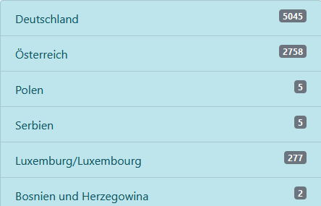
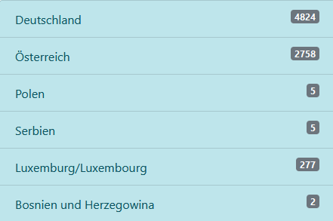
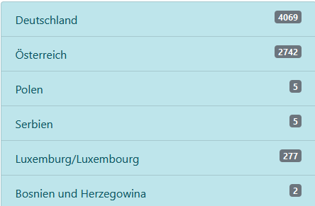
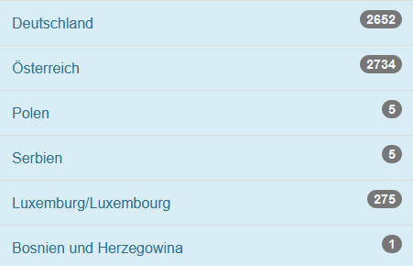
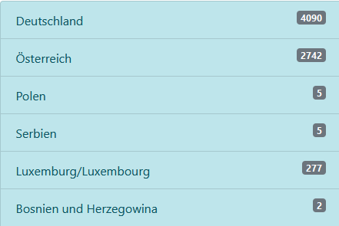
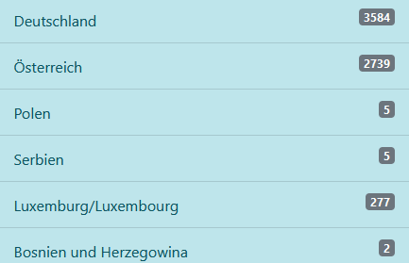
Matricula – Diocese Archives
  Austria
    St. Pölten, Oberöstereich, and Wien, covering the modern states of Upper Austria, Lower Austria and Vienna in northern Austria;
  Germany
    Contains 14 of 27 Dioceses
    Passau
    Osnabrück
  Poland
    Breslau
  Luxembourg
11 Oct 22
14 Oct 22
Sept 2022
15 Nov 24
Sept 20
14 Dec 24
https://data.matricula-online.eu/en/deutschland/

Slide 5
Matricula – Where?
There are two sites to visit:
  US: https://icar-us.eu/en/cooperation/online-portals/matricula/
  Europe: https://data.matricula-online.eu/en/
The first site has excellent overviews of the Project in English
  Tutorial
  The Collaboration Process
  Reference Aids
  Maps (particularly the useful Catholic Dioceses of Germany)
It will also direct you to the second site, the research site

Slide 6
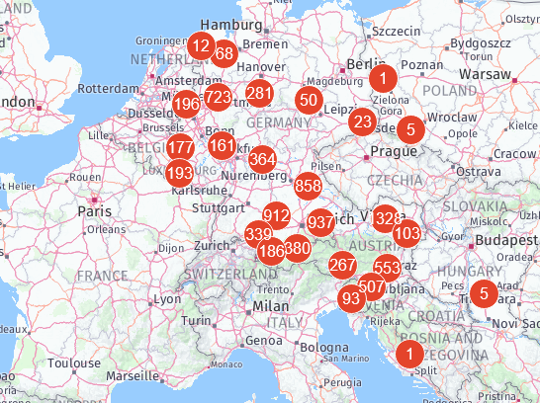
Matricula - Search
Search for Places
  Cities where family lived
  Churches where family attended
Search by Map
  Locate Churches

Slide 7
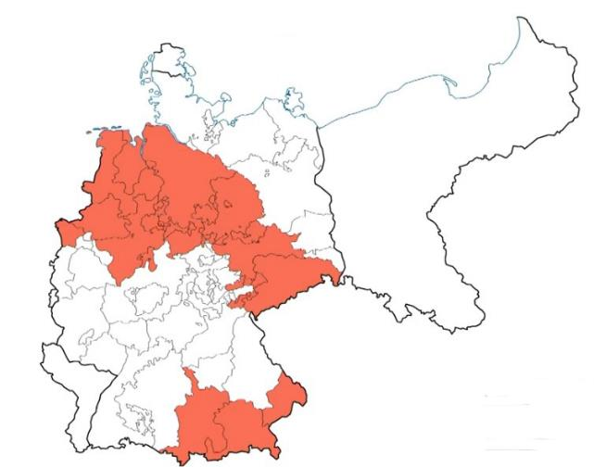
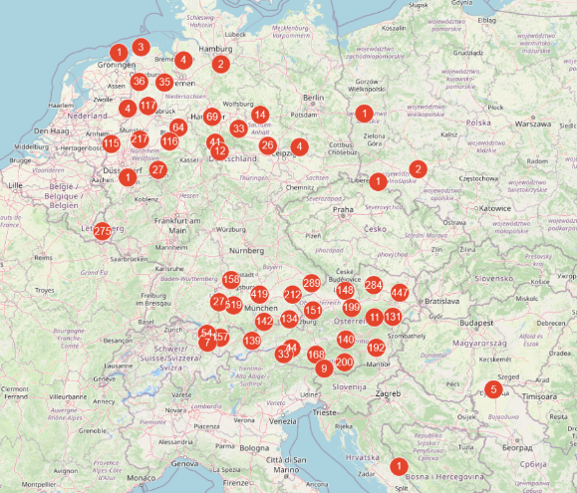
Matricula – Church Map
Identifies churches records that are on-line
Locate churches for which records are published
Matricula Map
14 Dec 24
Rootstech - Family Search
By Daniel R. Jones

Slide 8
Where to Start your Research
Collect your facts
  Family members
  Family friends
  Local government records
  United States Citizenship and Immigration Services (USCIS) Genealogy Division
  Other genealogy sources
Determine Locations
  Maps are important
  Birth location in Germany
  Where they live in Germany
Identify
  Birth dates
  Parent names
  Siblings names and dates
Collect as much information as you can about your family as each fact will be helpful

Slide 9
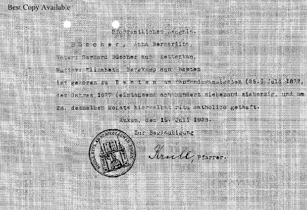
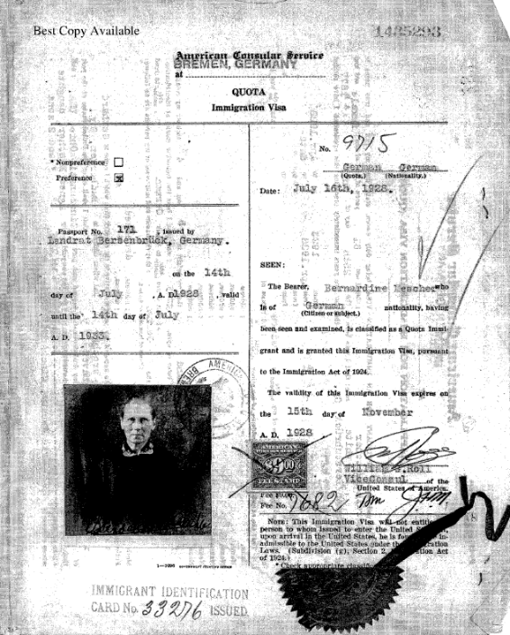
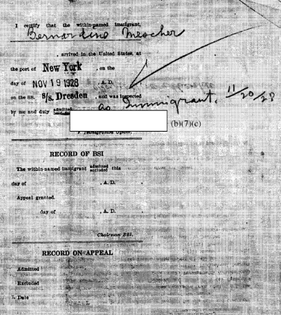
Collect your Facts/Documents
Anna Bernardina Büscher
Born 25 July 1877 in Besten, Germany
Marriage: 26 May 1898 Bersenbrück, Osnabruck, Niedersachsen, Germany (St. Vincentius)
Lived in Hertman, Germany
Arrived in the USA 19 Nov 1928
Died 17 Oct 1969 Covington, KY

Slide 10
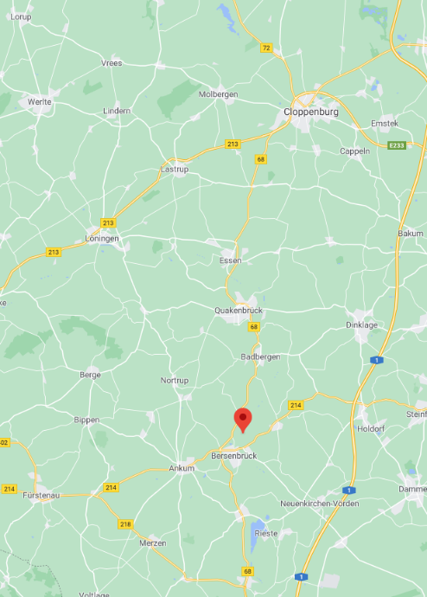
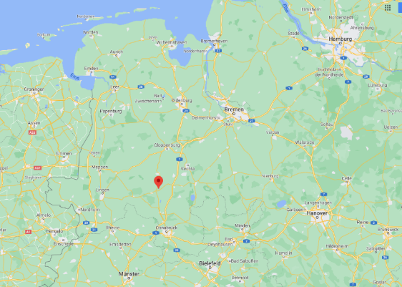
Maps – Family Members
Northwest Germany

Slide 11
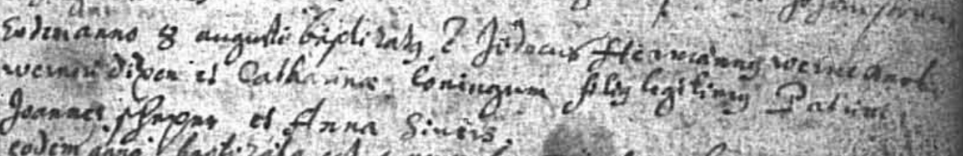
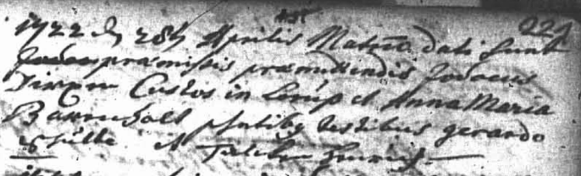
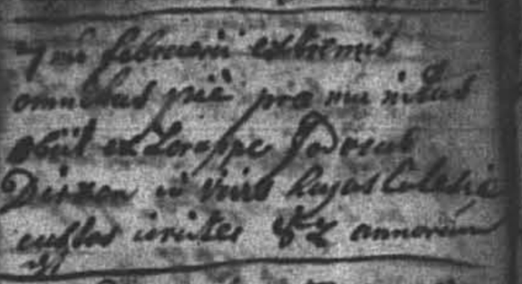
Collect your Facts/Documents
Jodocus Hermannus Dirxen
  AKA Jodocus Hermann (Jobst) Dirxen
Born: 8 Aug 1684
  Dörpen, Emsland, Niedersachsen, Germany (Dörpen St. Vitus)
Marriages:
  Lorup, Emsland, Niedersachsen, Germany (Lorup Mariä Himmelfahrt
  1st Marriage: 2 May 1713 to Hempe Gerries
  2nd Marriage: 22 May 1722 to Anna Maria Barenholt
Death:
  Lorup, Emsland, Niedersachsen, Germany (Lorup Mariä Himmelfahrt)
  7 Feb 1757

Slide 12
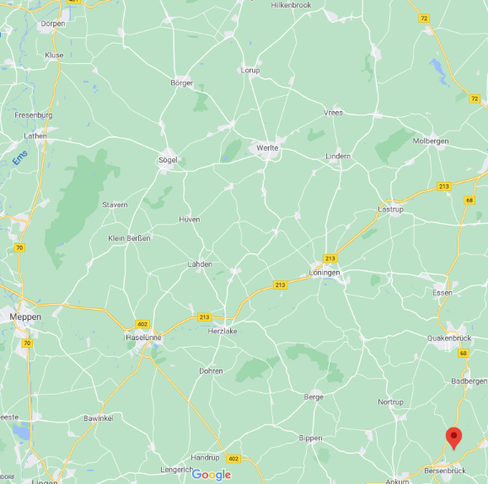
Dirxen Family
Northwest Germany

Slide 13
Matricula - Summary
Free to use
Need to be able to read the records
  German
  Latin
  French
Growing collection of church digitized records
  Contact the diocese/church of interest
Records are indexed by church
  Baptism
  Marriage
  Death
Some records are Indexed
  By person and year of event
  Unfortunately, not all records are indexed

Slide 14
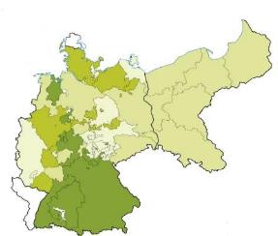
Other German Sources
Archion
  Focuses on Protestants religions (mostly Lutheran and Reformed)
    Also contains some Roman-Catholic Church, Mennonites
  Pay for access to information
  175,000 Church Books Online (and growing)
  Archion Website
    https://www.archion.de/
  Rootstech by Family Search - Daniel R Jones
    https://www.familysearch.org/rootstech/session/at-home-with-german-records-archion-and-matricula-part-2-of-2
Rootstech by Family Search
Daniel R.Jones

Slide 15
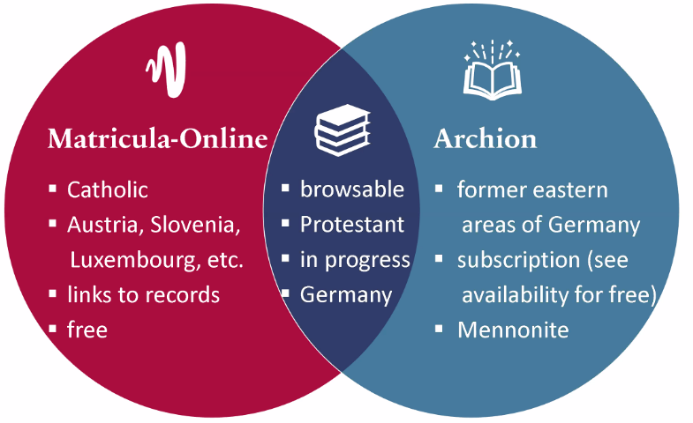
Matricula-Online Versus Archion

Slide 16
Other German Sources
Geneanet
  4M+ million community members who share their genealogical information
  Can search the entire database
    Some access requires subscription
  Access to other databases
    Genealogy Library with 3 billion index records
    Genealogical Society Indexes
  https://en.geneanet.org/
Rootstech by Family Search
Daniel R.Jones

Slide 17
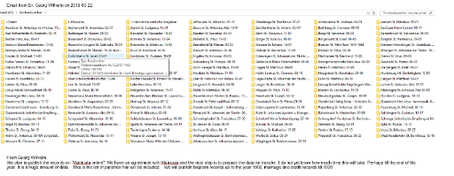
Not Able to Find Family?
Contact potential churches and for information
Contact Dioceses for information and assistance
Identify if there is a Genealogical Division in the region of interest
Example
  Diocese of Osnabrück
    Covers Northwest Germany
    Bistum Osnabrück Genealogical Research Center
    Ask how to access records
    What assistance do they provide
    Initially released church records 23 Oct 2019

Slide 18
Gazetteers
Gazetteer:
  a list of all localities within a given jurisdictions, such as a county, duchy, state, province, or empire.
  Information provided may vary depending on the original purpose of the publication and may include different government jurisdictions, church parish(es), population-, area,-and tax information, post office, description, history, and more.
Use them to search for potential location of family members
Online German Gazetteers and Parish Register Inventories
  https://www.familysearch.org/en/wiki/Online_German_Gazetteers_and_Parish_Register_Inventories

Slide 19
Gazetteers
MeyersGaz
  www.meyersgaz.org
GenWiki
  https://wiki.genealogy.net/Hauptseite
Kartenmeister
  www.kartenmeister.com
Westpreussen.de
  www.westpreussen.de
LAGIS Hessen Historisches Ortslexikon
  www.lagis-hessen.de
Pommerscher Greif
  www.pommerscher-greif.de
FamilySearch Wiki
  www.familysearch.org/en/wiki
Deutsch-Fremdsprachiges Ortsnamenverzeichnis
  https://pbc.gda.pl/dlibra/docmetadata?id=7346&from=pubstats
Family Search – German Genealogy
  https://www.familysearch.org/en/wiki/Germany_Genealogy

Slide 20
German Internet Resources
James M. Beidler’s
  “Trace Your German Roots Online” (2015)
Can’t find your church? Check
  Ancestry.com
  German Catholic Church website:
    Kirche in Deutschland
  Others
    Geneanet

Slide 21
Summary
Collect family member’s facts
  As much as possible
Use the resources available
Be patient
  New records are added all the time
Be persistent
  Do not give up – it may take time

Slide 22
Research
Happy Hunting!

