Slide 1
European Sources
Matricula-Online / Archion /Geneanet
David F. Lahrmann

Slide 2
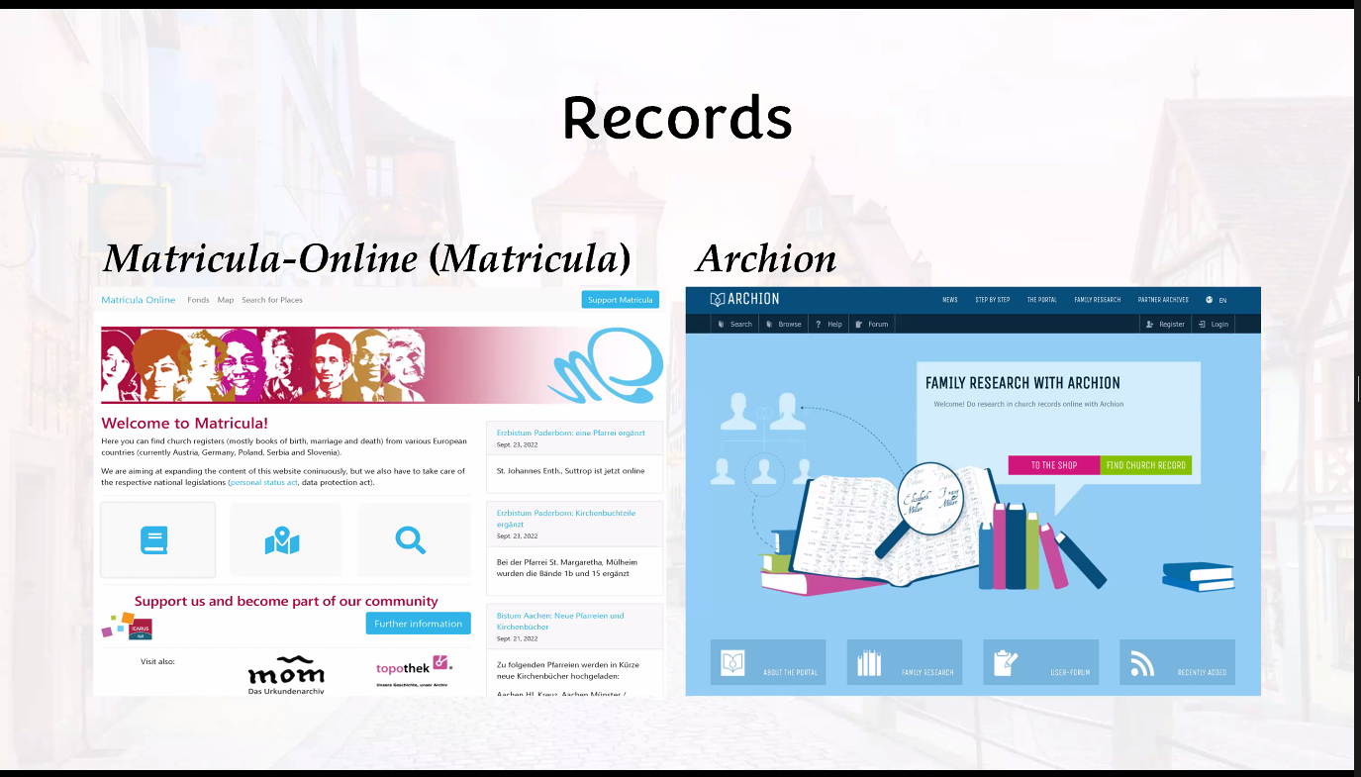
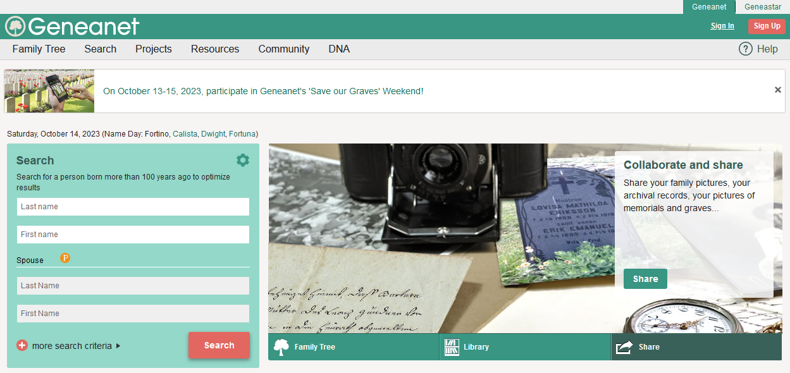
Sources for German Birth, Marriage and Death Records
Martricula – Online
  Free
  https://data.matricula-online.eu/en/
Achion
  Fee based service
  https://www.archion.de/en/
Geneanet
  Free and pay to access
  https://en.geneanet.org/

Slide 3
Matricula – What is It?
  Austrian nonprofit organization
    International Centre for Archival Research - US (ICARUS)
    Seeks to digitize church records, (matricula is Latin for “register”)
    Vital records kept by the Catholic Church
  The Project
    Online Registers Database
    More than seven million pages of church records online and growing
    Includes Catholic church records from the 1500s to the 1900s.

Slide 4
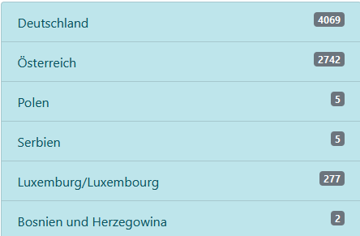
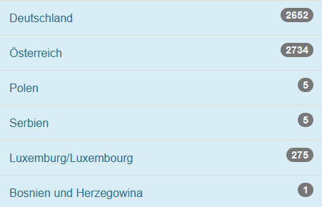
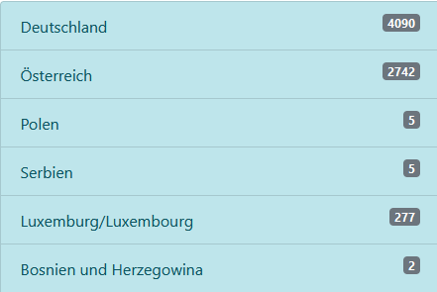
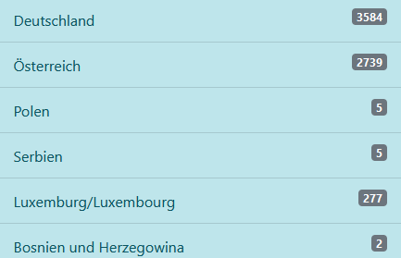
Matricula – Diocese Archives
  Austria
    St. Pölten, Oberöstereich, and Wien, covering the modern states of Upper Austria, Lower Austria and Vienna in northern Austria;
  Germany
    Contains 14 of 27 Diocese
    Passau
    Osnabrück
  Poland
    Breslau
  Luxenburg
Sept 2020
Sept 2022
11 Oct 2022
14 Oct 2022
https://data.matricula-online.eu/en/deutschland/

Slide 5
Matricula – Where?
There are two sites to visit:
  US: https://icar-us.eu/en/cooperation/online-portals/matricula/
  Europe: https://data.matricula-online.eu/en/
The first site has excellent overviews of the Project in English
  Tutorial
  The Collaboration Process
  Reference Aids
  Maps (particularly the useful Catholic Dioceses of Germany)
It will also direct you to the second, the research site

Slide 6
Matricula – One Can
Search for Places
  Cities where family lived
  Churches where family attended
  Identify the parish the church belongs
Search by Map
  Locate Churches

Slide 7
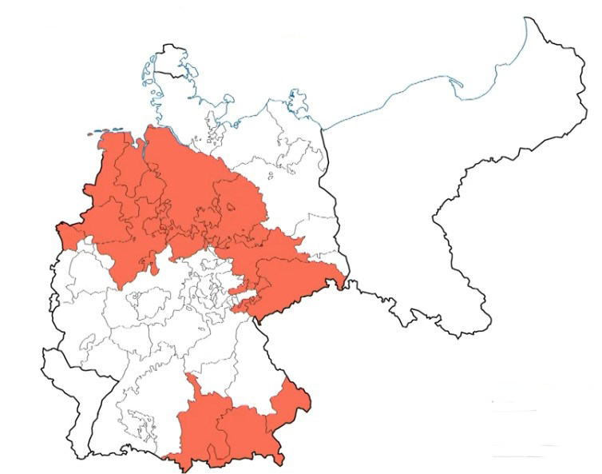
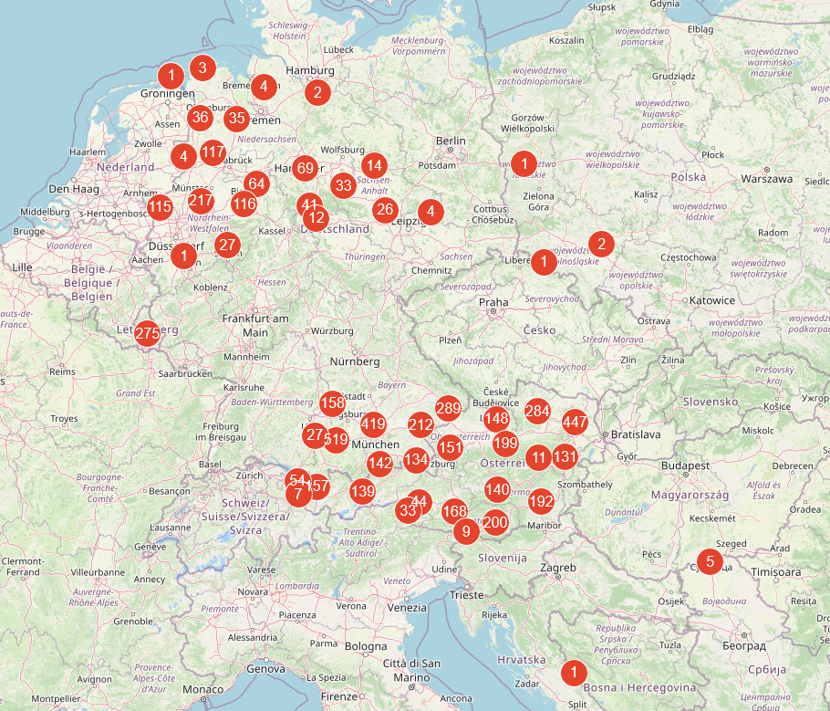
Matricula – Church Map
Identifies churches records that are on-line
Locate churches for which records are published
Matricula Map
Rootstech - Family Search
By Daniel R. Jones

Slide 8
Where to Start your Search
Collect your facts
  Family members
  Family friends
  Local government records
  United States Citizenship and Immigration Services (USCIS) Genealogy Division
  Other genealogy sources
Determine Locations
  Birth location in Germany
  Where they live in Germany
Identify
  Birth dates
  Parent names
  Siblings names and dates

Slide 9
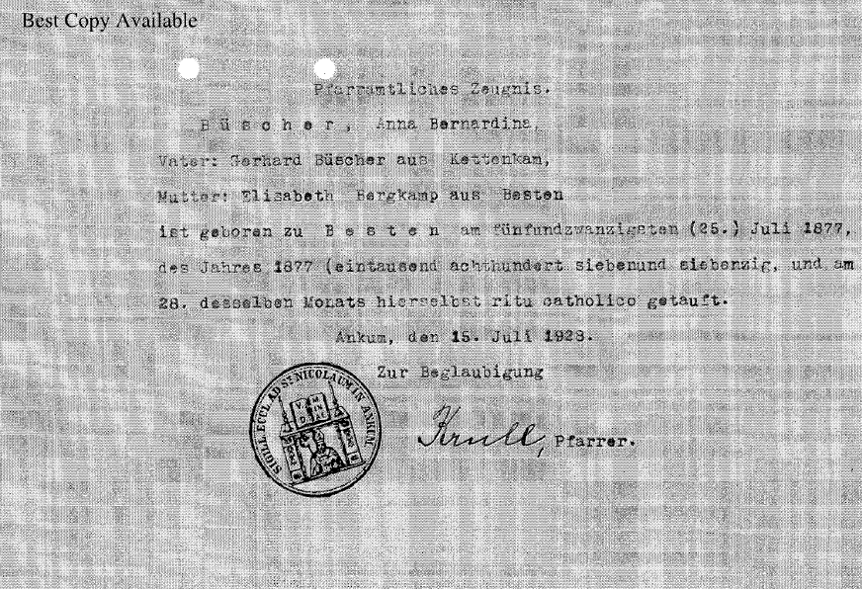
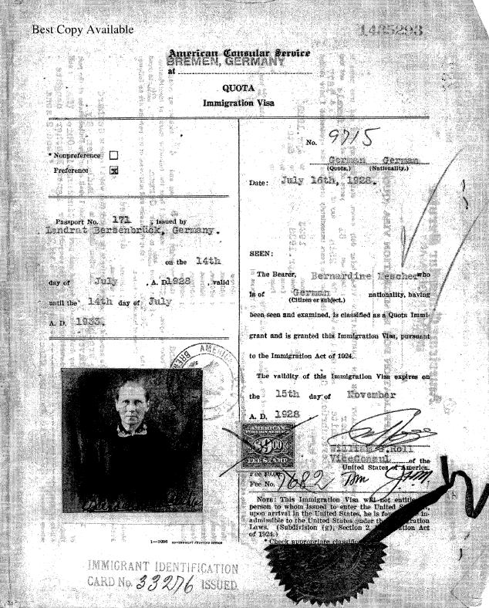
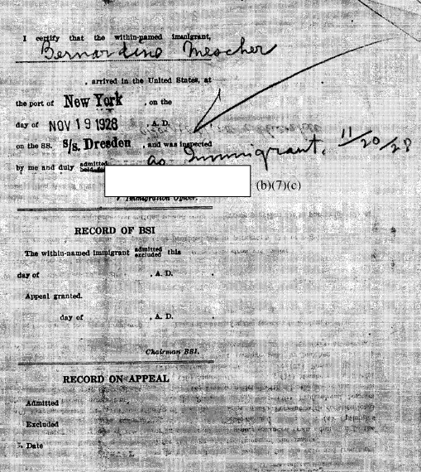
Collect your Facts/Documents
Anna Bernardina Büscher
Born 25 July 1877 in Besten, Germany
Marriage: 26 May 1898 Bersenbrück, Osnabruck, Niedersachsen, Germany (St. Vincentius)
Live in Hertman, Germany
Arrived in the USA 19 Nov 1928
Died 17 Oct 1969 Covington, KY
Matricula Online

Slide 10
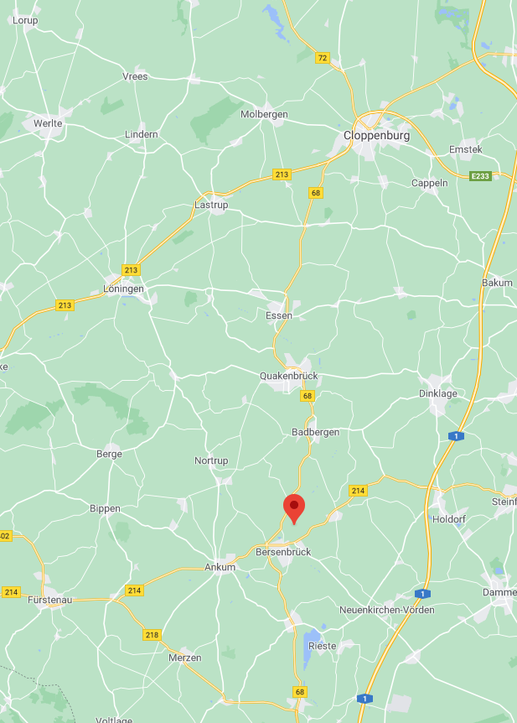
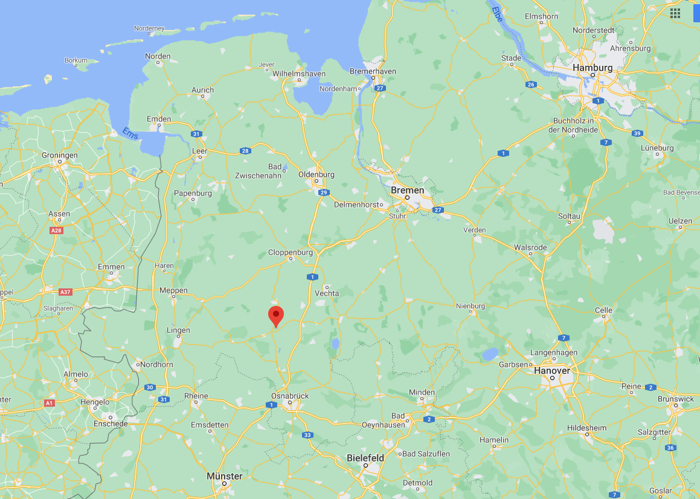
Maps – Family Members
North West Germany

Slide 11
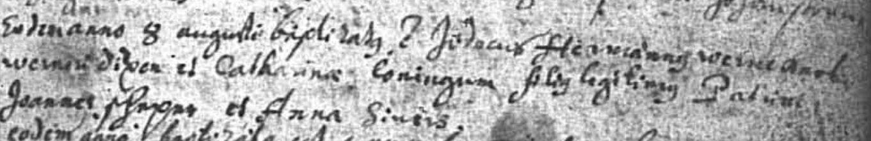
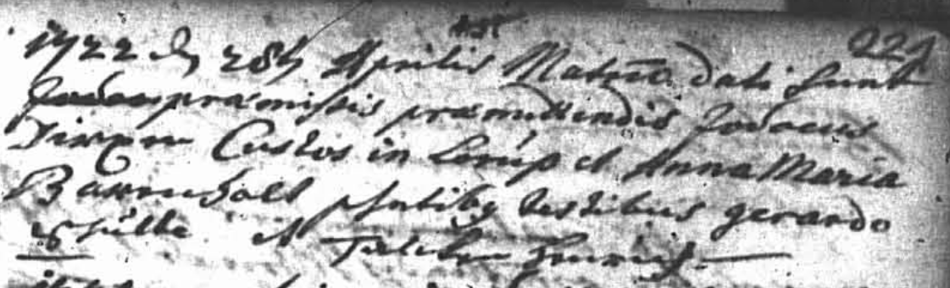
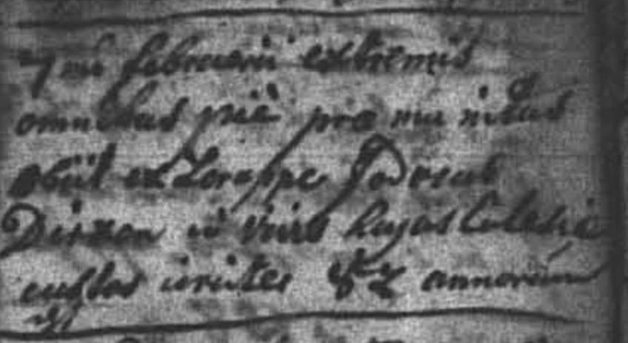
Collect your Facts/Documents
Jodocus Hermannus Dirxen
  AKA Jodocus Hermann (Jobst) Dirxen
Born: 8 Aug 1684 in Dörpen, Emsland, Niedersachsen, Germany (Dörpen St. Vitus)
2nd Marriage: 2 May 1713 in Lorup, Emsland, Niedersachsen, Germany (Lorup Mariä Himmelfahrt)
Death: 7 Feb 1757 in Lorup, Emsland, Niedersachsen, Germany (Lorup Mariä Himmelfahrt)

Slide 12
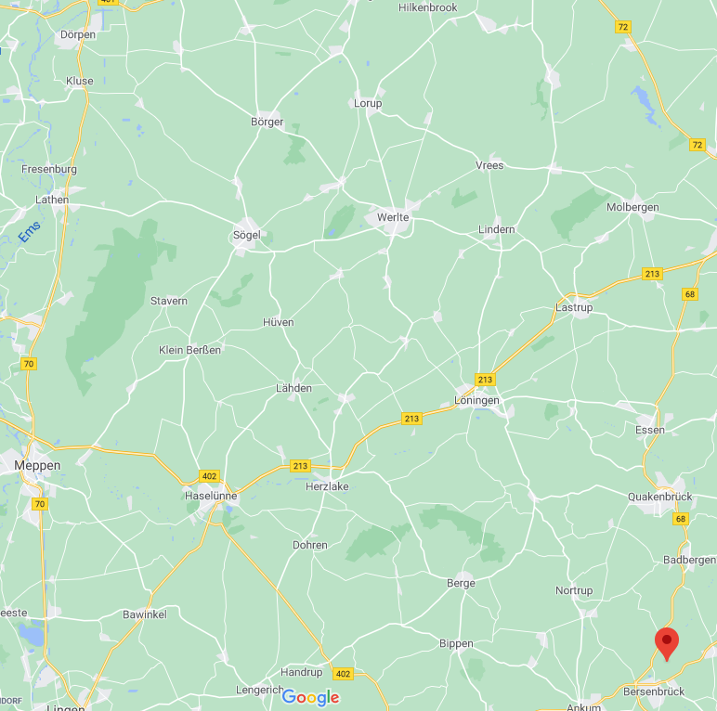
Dirxen Family
Northwest Germany

Slide 13
Matricula - Summary
Free to use
Need to be able to read the records
  German
  Latin
Growing collection of church digitized records
  Contact the church of interest
Records are indexed by church
  Baptism
  Marriage
  Death
  Date
Records are not index by family name - unfortunately

Slide 14
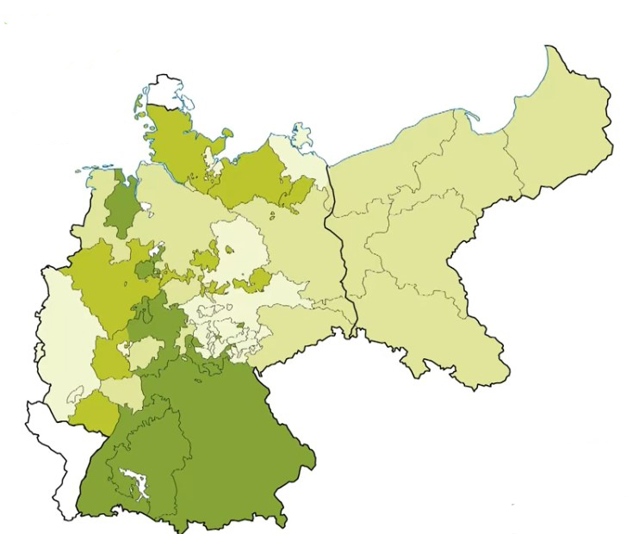
Other German Sources
Archion
  Focuses mostly on Protestants religions (mostly Lutheran and Reformed)
    Also contains some Roman-Catholic Church, Mennonites
  Pay for access to information
  150,000 Church Books Online
  Archion Website
    https://www.archion.de/
  Rootstech by Family Search - Daniel R Jones
    https://www.familysearch.org/rootstech/session/at-home-with-german-records-archion-and-matricula-part-2-of-2
Geneanet
  4M+ million community members who share their genealogical information for free
  Can search the entire database
  Some access requires a subscription
  https://en.geneanet.org/
Rootstech by Family Search
Daniel R.Jones

Slide 15
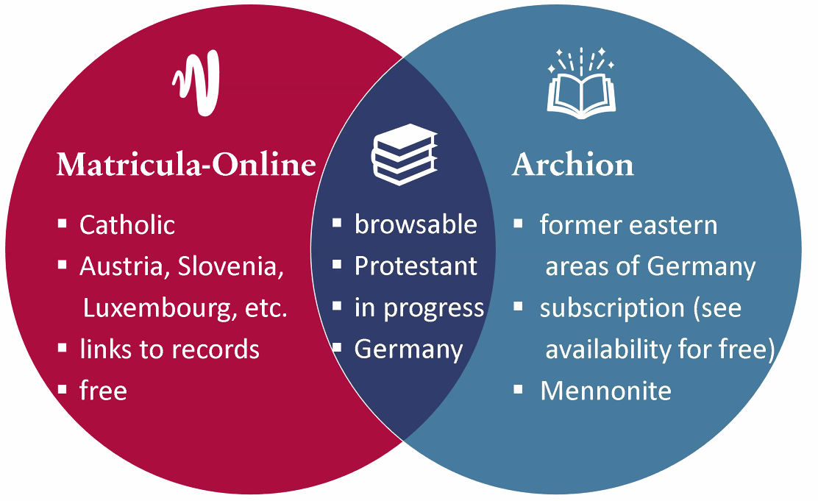
Matricula-Online Versus Archion

Slide 16
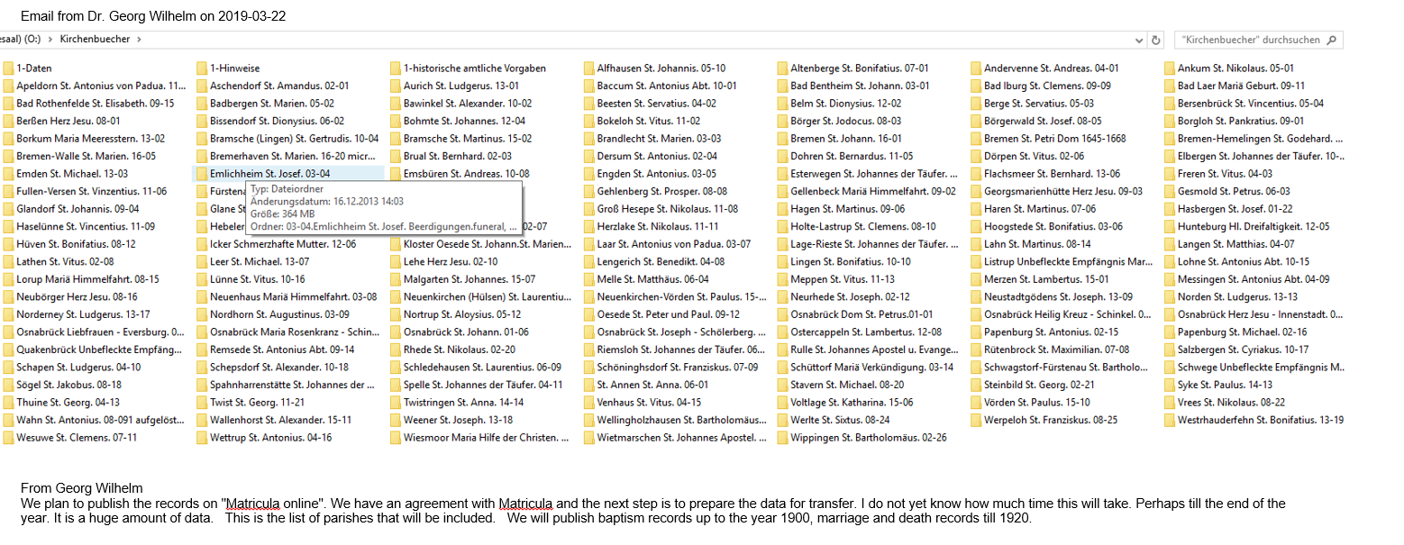
Not Able to Find Family?
Contact potential churches for information
Contact Parishes for information and assistance
Identify if there is a Genealogical Division in the region of interest
Example
  Parish of Osnabrück
    Covers Northwest Germany
    Bistum Osnabrück Genealogical Research Center
    Ask how to access records
    What assistance do they provide
    Initially released church records 23 Oct 2019

Slide 17
Gazetteers
Gazetteer: a list of all localities within a given jurisdictions, such as a county, duchy, state, province, or empire. Information provided may vary depending on the original purpose of the publication and may include different government jurisdictions, church parish(es), population-, area,-and tax information, post office, description, history, and more.
Use these to search for potential location of family memebers
Online German Gazetteers and Parish Register Inventories
  https://www.familysearch.org/en/wiki/Online_German_Gazetteers_and_Parish_Register_Inventories

Slide 18
Gazetteers
MeyersGaz
  www.meyersgaz.org
GenWiki
  www.wiki.genealogy.net
Kartenmeister
  www.kartenmeister.com
Westpreussen.de
  www.westpreussen.de
LAGIS Hessen Historisches Ortslexikon
  www.lagis-hessen.de
Pommerscher Greif
  www.pommerscher-greif.de
FamilySearch Wiki
  www.familysearch.org/en/wiki
Deutsch-Fremdsprachiges Ortsnamenverzeichnis
  https://pbc.gda.pl/dlibra/docmetadata?id=7346&from=pubstats
Family Search – German Genealogy
  https://www.familysearch.org/en/wiki/Germany_Genealogy

Slide 19
German Internet Resources
James M. Beidler’s
  “Trace Your German Roots Online” (2015)
Can’t find your church? Check
  Ancestry.com
  German Catholic Church website:
    Kirche in Deutschland
  Others
    Geneanet

Slide 20
Summary
Collect family member’s facts
  As much as possible
Use the resources available
Be patient
  New records are added all the time
Be persistent
  Do not give up – it may take time

Slide 21
Research
Happy Hunting!

