Slide 1
Basic Charts and Forms
Dr. Tom Montgomery, Kolping Member

Slide 2
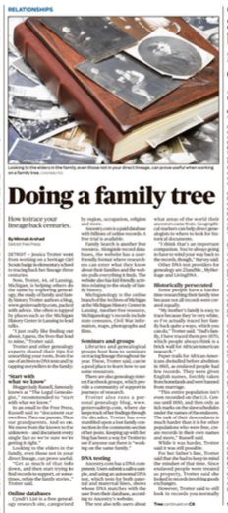
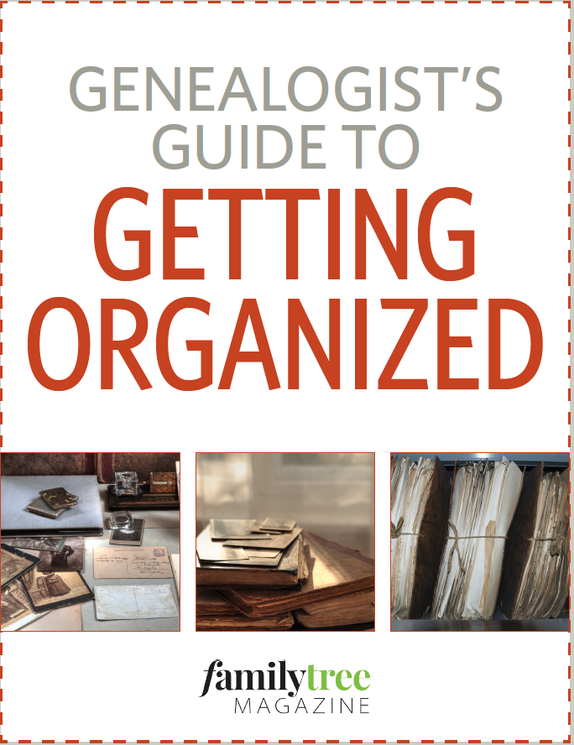
Why?
Your Spark!
Get Organized
Schedule weekly
Collaborate:
Family/Friends

Slide 3
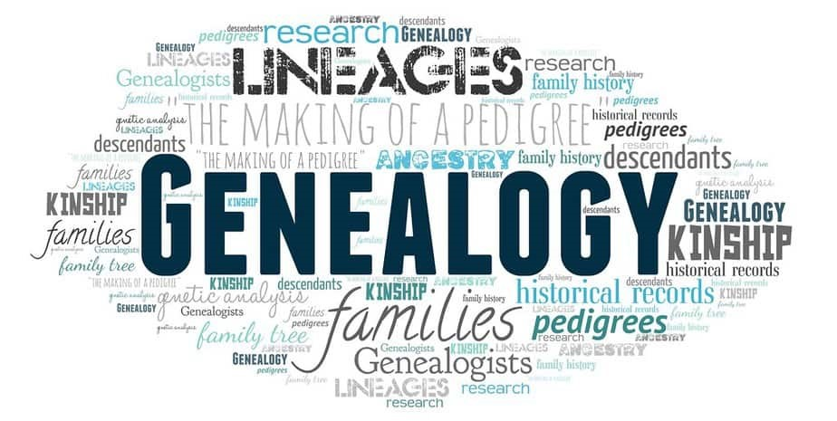
Getting Started
You need to decide a system that you can use.
  Binder
  Files
  Computer
Organize
  By individual person
  By location
  To Do List

Slide 4
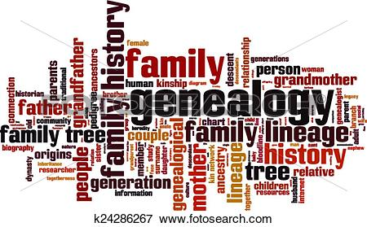
Doing a Family Tree
Tips for Unearthing Your Roots
Start with what we know
Online databases
Seminars and groups
DNA testing

Slide 5
General: Ancestral Chart (Ancestry)
An ancestor chart records the ancestors from whom you directly descend--those for whom you intend to compile a complete and correct family unit. It shows at a glance the progress you have made towards this goal and what remains to be done.
https://www.ancestry.com/cs/charts-and-forms
https://www.archives.gov/research/genealogy/charts-forms
Notes:
Ancestry.com
Review Ancestral Chart
Review Research Calendar
Review Research Extract
Review Correspondence Record
Review Family Group Record
Review Source Summary

Slide 6
Five Generation Pedigree Chart
Record your ancestors’ vital stats on this standard five-generation pedigree chart.
https://www.familytreemagazine.com/freebie/fivegenerationancestorchart/
Or https://www.archives.gov/files/research/genealogy/charts-forms/ancestral-chart.pdf
Notes:
Review and compare three charts:
1a-anchart.pdf
1b-ancestral chart.pdf. PRINT
1c-ancestor-5.pdf

Slide 7
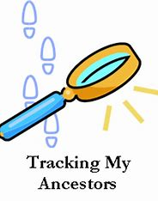
Tracking your Research
Research Calendar
Research Extract
Correspondence Record
Notes:
Research Calendar
Research Extract
Correspondence Record. PRINT ALL

Slide 8
Research Calendar (Ancestry)
  The research calendar gives an account of every record source you have searched and serves as a reminder of what you have already done and where you have found pertinent information.
  https://www.ancestrycdn.com/legacy/pdf/trees/charts/rescal.pdf
Notes:
Review Research Calendar PRINT

Slide 9
Family Group Record (Ancestry)
Each piece of information concerning a pedigree ancestor and his/her family is placed on a worksheet. Since the end result of your research efforts will be to compile complete, correct and connected families, the use of family group sheets from the beginning will make the compilation much easier.
https://www.ancestrycdn.com/legacy/pdf/trees/charts/famgrec.pdf
Always track your research using Source Summary sheets
Notes:
Complete a Family Group Record Sheet. PRINT

Slide 10
Individual Worksheet
(Midwest Genealogy Center)
Worksheet to serve as a guide for biographical information about an individual
https://www.mymcpl.org/sites/default/files/06-0015%20Individual%20Worksheet.pdf
Track your Research: Biographical Outline
Notes:
Complete an Individual Work Sheet PRINT

Slide 11
Biographical Chart (Family Tree Maker)
Record information on education, military service, marriage, children, illnesses, religious milestones, migrations, residences, jobs, family events, land purchases, death and burials, etc.
https://www.familytreemagazine.com/freebie/biographicaloutline/
Notes:
Complete a Biographical Chart PRINT

Slide 12
Marriage Form (Family Tree Maker)
This form will help you extract information from your ancestors’ marriage indexes. Like it is for us today, marriage was a crucial step in our ancestors’ lives. Celebrate your ancestors’ love by recording the day they started a life together on thismarriage index worksheet.
https://familytreemagazine.com/freebie/free-form-record-marriage-records/
Notes:
Review Marriage Index form. PRINT

Slide 13
Relationship Chart (Family Tree Maker)
Let this chart help you figure out how a family member is related to you.
https://www.familytreemagazine.com/freebie/relationshipchart/

Slide 14
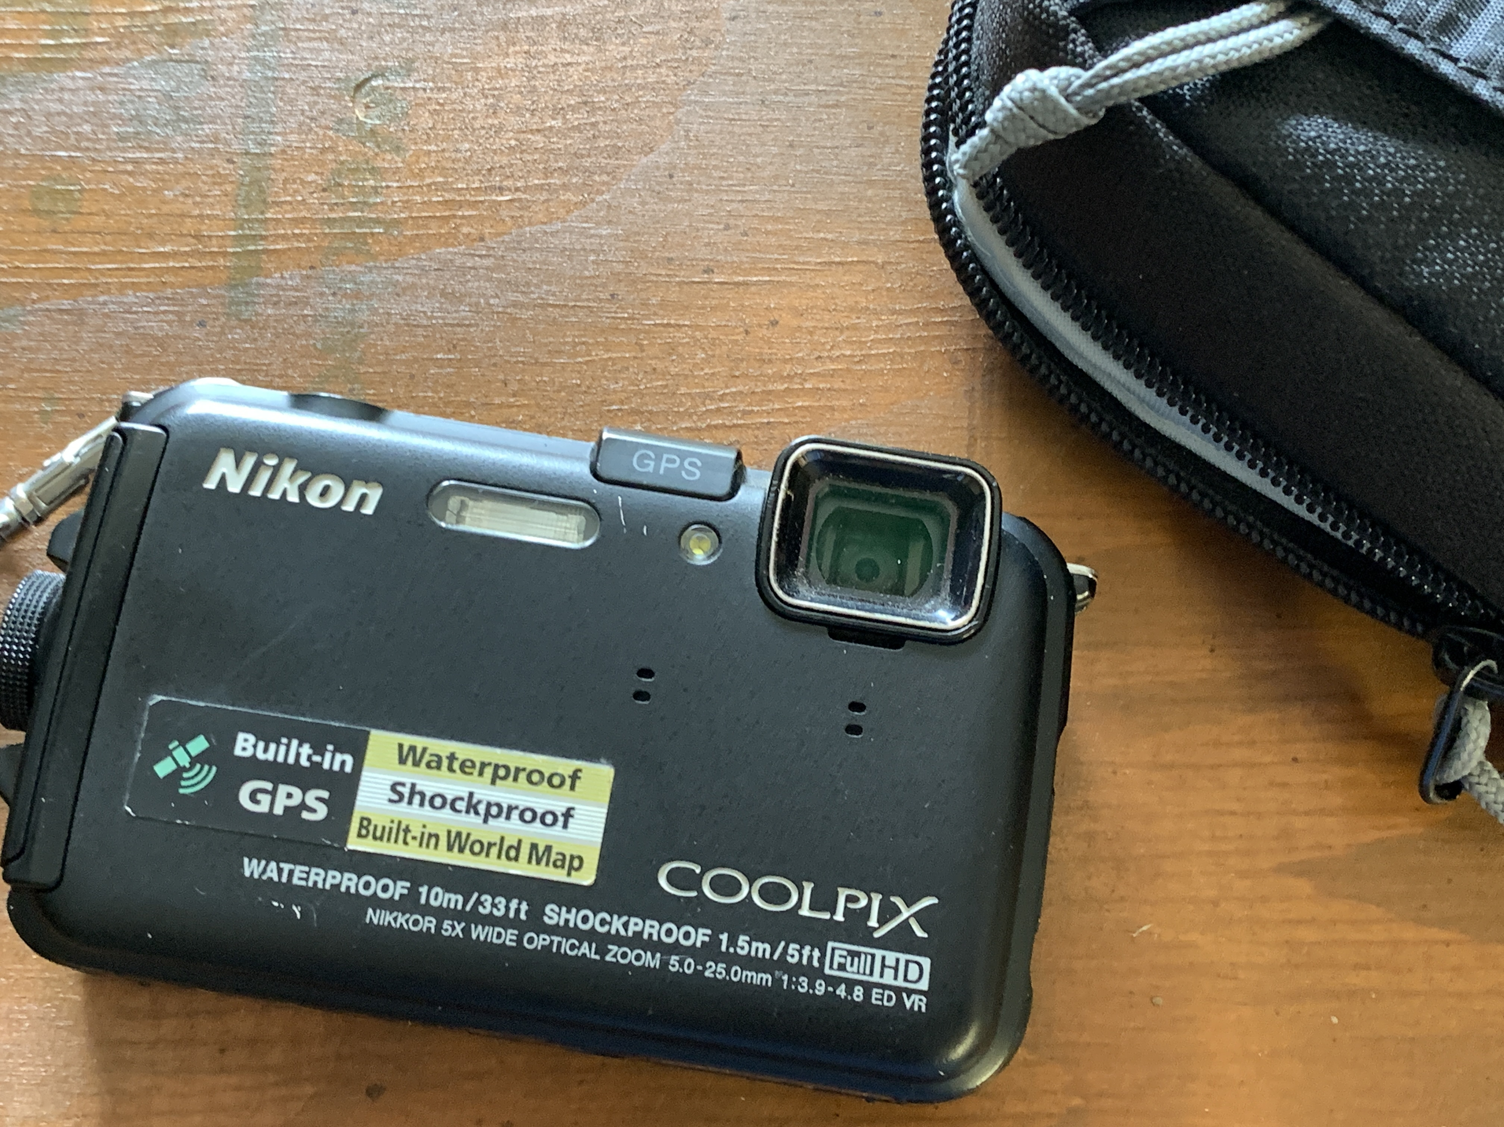
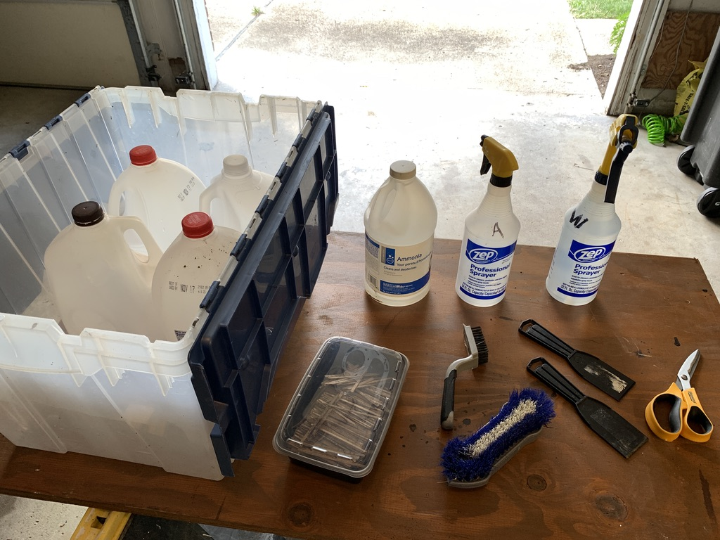
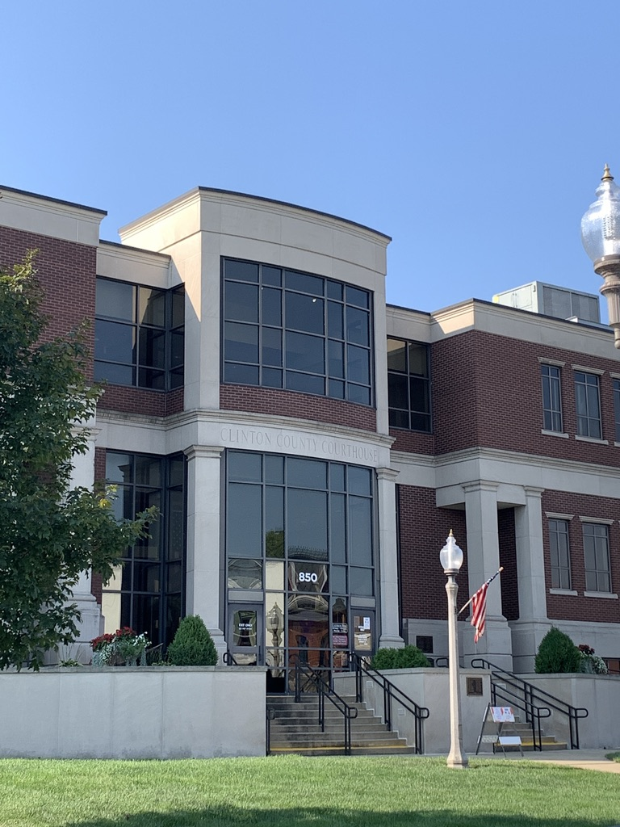
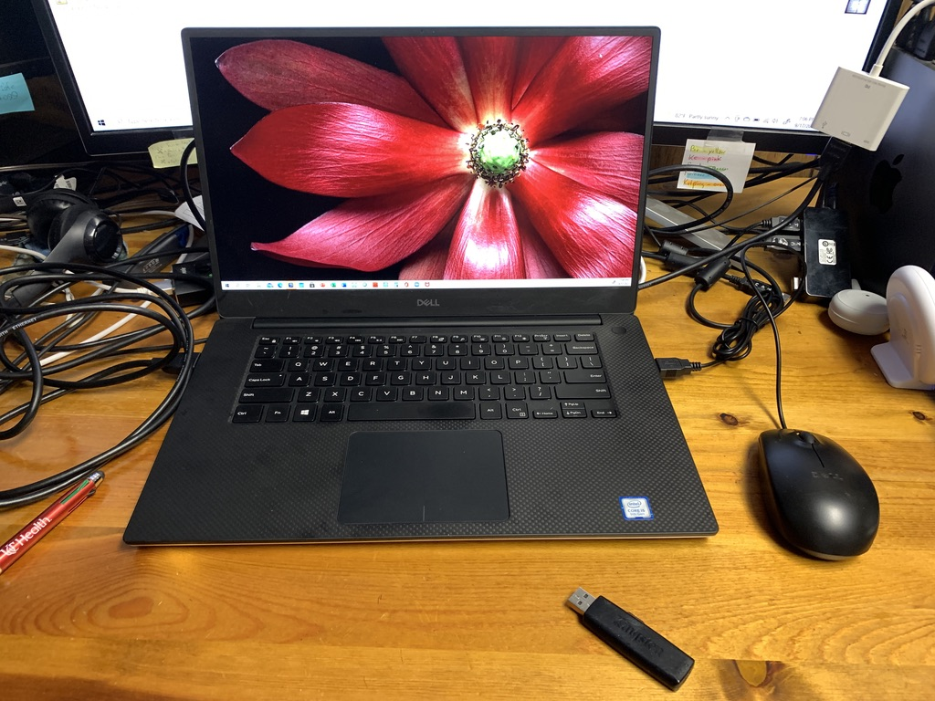
Your Gear
Notebook/Writing Tablets
Cell Phone/Camera
Your Files
Laptop/USB drives
Cemetery Kit

Slide 15
Finding Your Roots
Start with What We Know
Research the Online Databases
Attend Seminars and join Groups = Learn & Share!
Blood lines: DNA testing
Review History and Geography (carry maps)
Digitize Your Documents (download or scan yourself)
Backup your Files (paper and electronic)

Slide 16
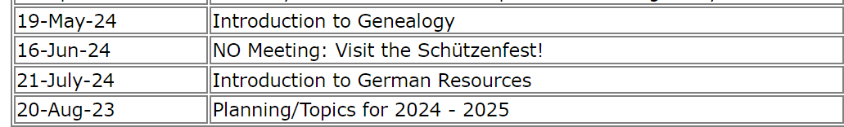
Next Month
  Always check the website: http://www.kolpingcincinnati.com/Genealogy/Genealogy.html

Slide 17
Research
Happy Hunting!

